Slide 1
Decision Trees - Regression
~ Pankaj

Slide 2
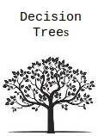
Decision Tree - Explanation
Decision Tree is a decision-making tool that uses a flowchart-like tree structure or is a model of decisions and all of their possible results, including outcomes, input costs and utility.

Slide 3
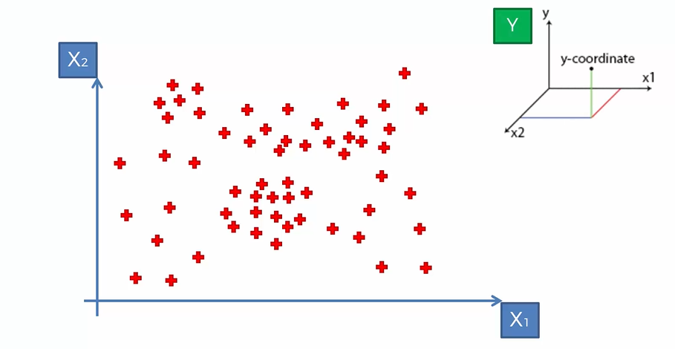
Decision Tree - Explanation

Slide 4
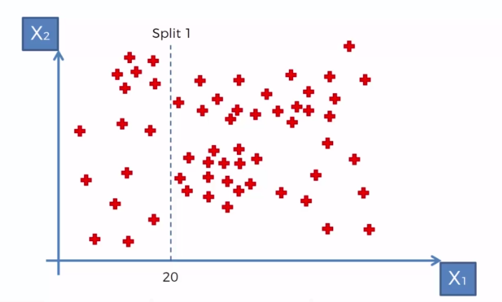
Decision Tree - Explanation

Slide 5
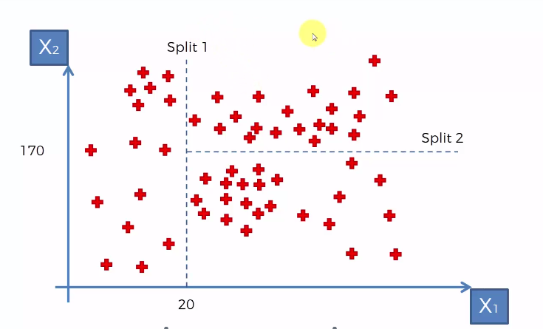
Decision Tree - Explanation

Slide 6
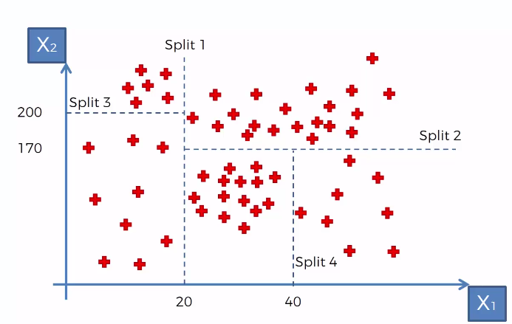
Decision Tree - Explanation

Slide 7
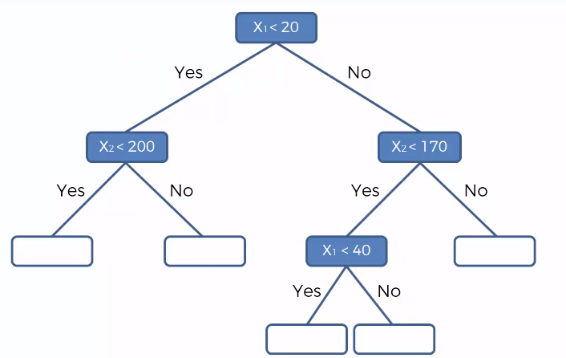
Decision Tree - Explanation

Slide 8
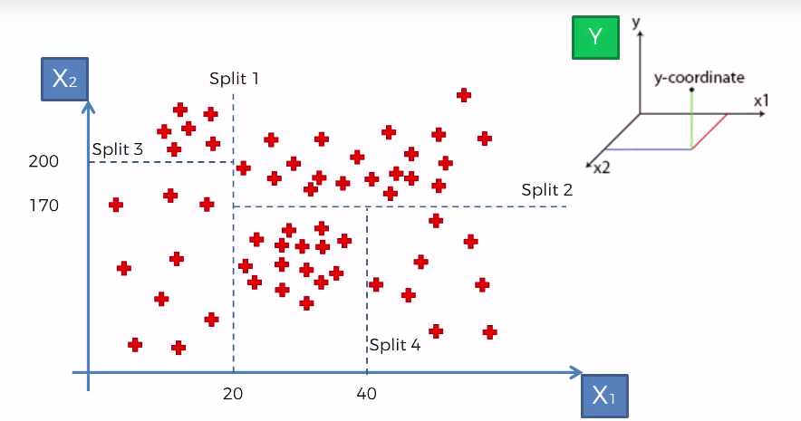
Decision Tree - Explanation

Slide 9
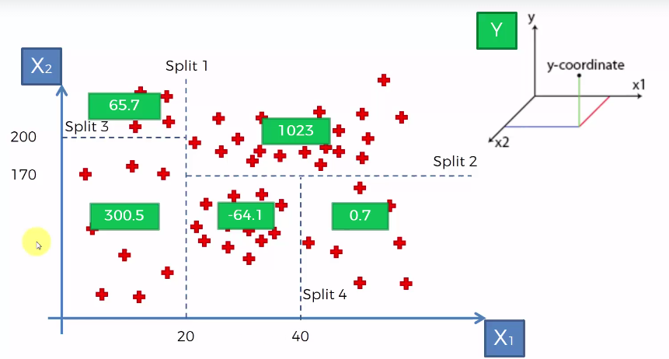
Decision Tree - Explanation

Slide 10
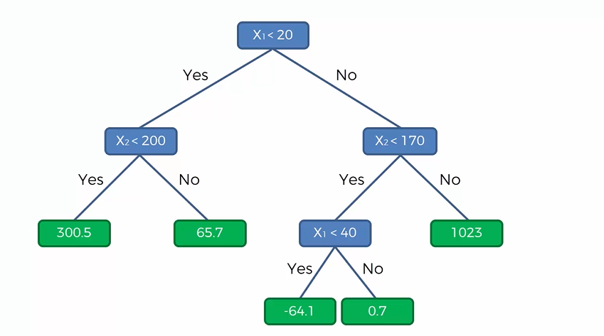
Decision Tree - Explanation

Slide 11
Decision Tree - Explanation
Internal Working of Decision Trees:
https://www.saedsayad.com/decision_tree_reg.htm

Slide 12
Decision Trees
Con:
Decision Trees– Bias
How to avoid the Bias on Decision Trees?
Prunning Techniue – Stopping to growth of tree.
Approach :
Top – Down
Bottom Up

Slide 13
Random Forest- Regression
~ Pankaj

Slide 14
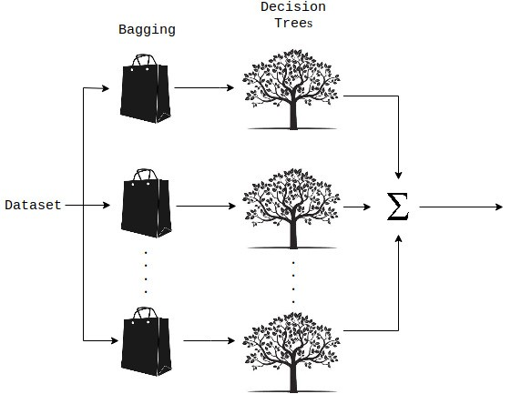
Random Forest- Explanation
A Random Forest is an ensemble technique.
It is capable of performing both tasks with the use of multiple decision trees and a technique called Bootstrap Aggregation, commonly known as bagging.
What is bagging?
Bagging, in the Random Forest method, involves training each decision tree on a different data sample where sampling is done with replacement.

Slide 15
Random Forest- Explanation
The basic idea behind this is to combine multiple decision trees in determining the final output rather than relying on individual decision trees.

Slide 16
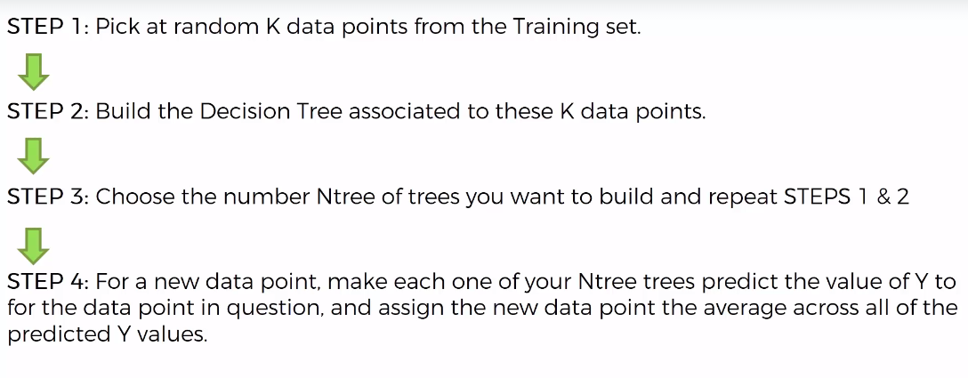
Random Forest- Explanation

